Slide 1
Sobel Edge detection
104062229 毛羿宣

Slide 2
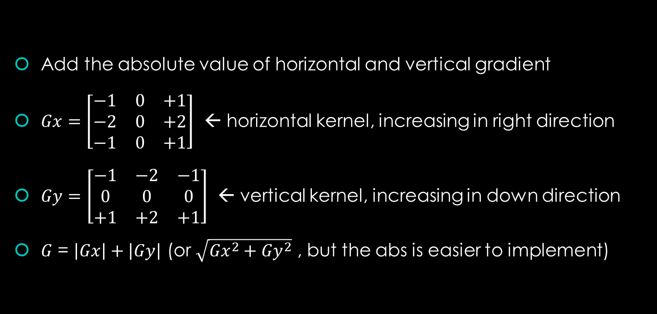
What is Sobel Edge Detector?
Add the absolute value of horizontal and vertical gradient
$Gx=\left[\begin{matrix}−1 & 0 & +1 \\ −2 & 0 & +2 \\ −1 & 0 & +1\end{matrix}\right]$ ← horizontal kernel, increasing in right direction
$Gy=\left[\begin{matrix}−1 & −2 & −1 \\ 0 & 0 & 0 \\ +1 & +2 & +1\end{matrix}\right]$ ← vertical kernel, increasing in down direction
$G$ = $\left|Gx\right|+\left|Gy\right|$ (or $\sqrt{{Gx}^{2}+{Gy}^{2}}$ , but the abs is easier to implement)

Slide 3
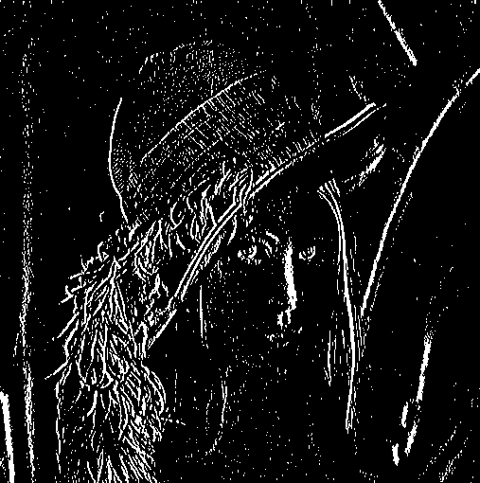
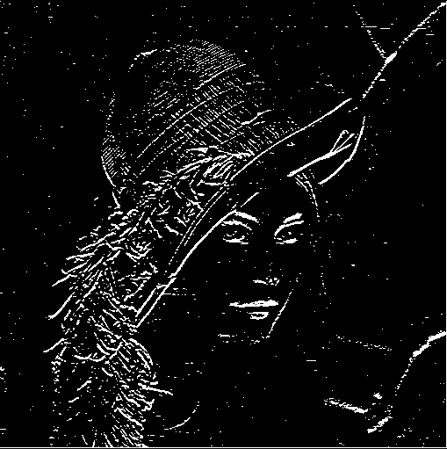
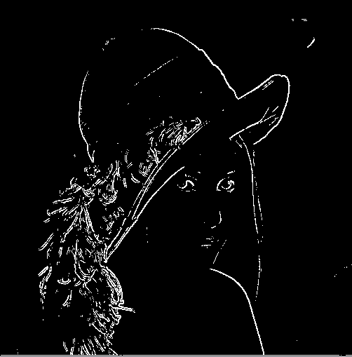
Compare the result
Gx
Gy
G

Slide 4
How to implement?

Slide 5
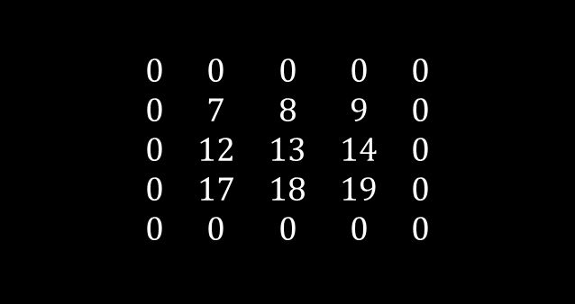
Read data
Move the window
$$\begin{matrix}0 & 0 & 0 & 0 & 0 \\ 0 & 7 & 8 & 9 & 0 \\ 0 & 12 & 13 & 14 & 0 \\ 0 & 17 & 18 & 19 & 0 \\ 0 & 0 & 0 & 0 & 0\end{matrix}$$
Every time we move the window, just shift all data to the left side
* For simplicity, I put the outside of the matrix to 0

Slide 6

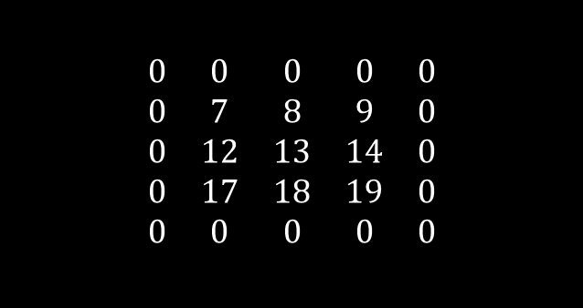
Calculate
Move the window
$$\begin{matrix}0 & 0 & 0 & 0 & 0 \\ 0 & 7 & 8 & 9 & 0 \\ 0 & 12 & 13 & 14 & 0 \\ 0 & 17 & 18 & 19 & 0 \\ 0 & 0 & 0 & 0 & 0\end{matrix}$$
$$Gx=\left[\begin{matrix}−1 & 0 & +1 \\ −2 & 0 & +2 \\ −1 & 0 & +1\end{matrix}\right]$$
=>0+ 0 + 0
+ 0+ 7*0 + 8*2
+0+ 12*0 + 13*1
= 29

Slide 7
Finite State Machine
READDATA2
READDATA1
READDATA3
Pcpi_insn_valid
col <=1
col >1
IDLE
pcpi_rs2[8:0] == 0 || pcpi_rs2[17:9] == 0
CALC
DONE

Slide 8
Software
Control the row and column value
Call hard_pcpi
Select which data to run

Slide 9

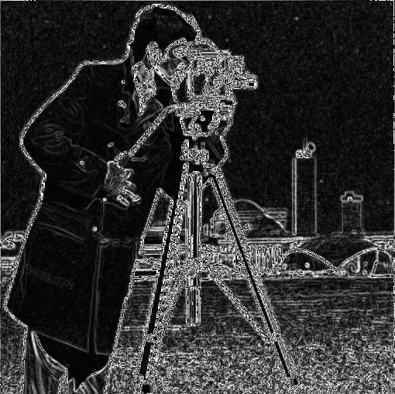


Result
Threshold = 0
Threshold = 100
Threshold = 250

